Slide 1
OBJECT ORIENTED PROGRAMMING
Understanding the Basics: OOPS
Object-Oriented Programming is like a game of building blocks, where each block represents a reusable component called an object. These objects encapsulate data and behavior, allowing us to create modular, flexible, and scalable applications. To truly grasp OOPS, let’s start with a analogy:

Slide 2
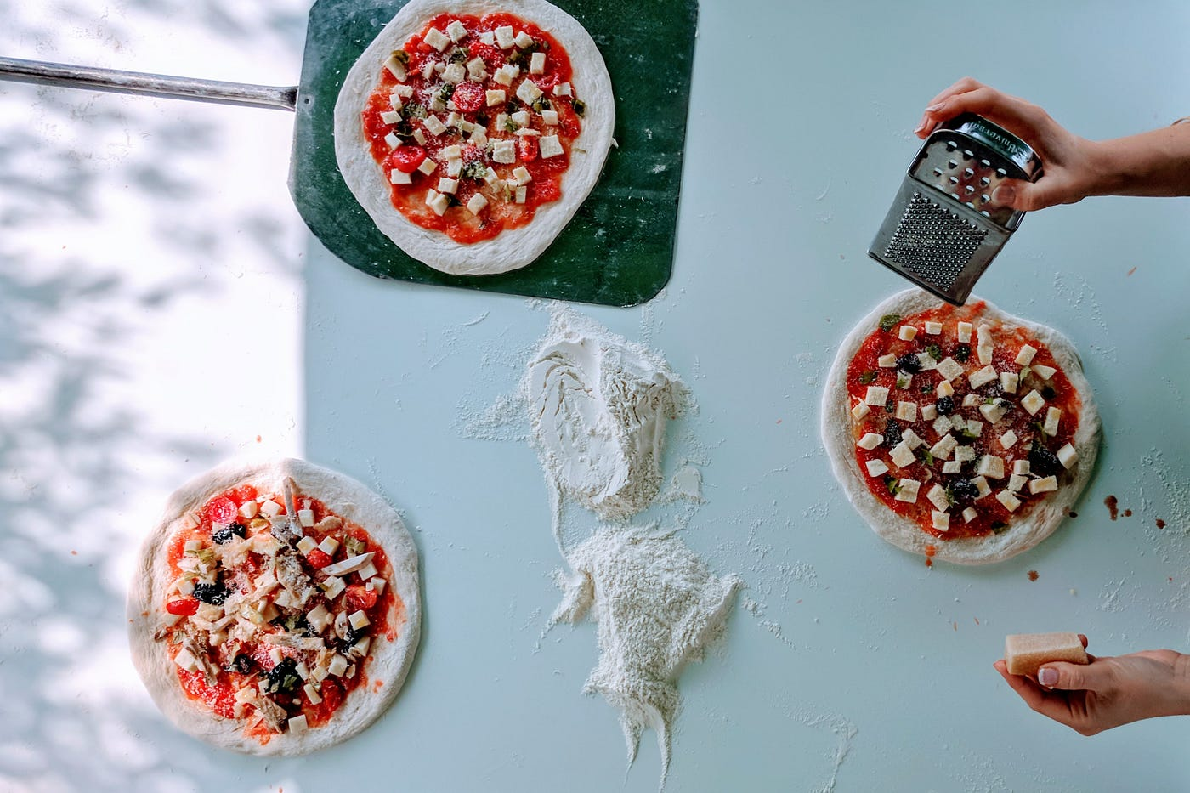
OBJECT ORIENTED PROGRAMMING
Understanding the Basics: OOPS
Imagine you’re a chef creating a delicious recipe. Each ingredient is an object, like a tomato, an onion, or a piece of chocolate. These ingredients have attributes (properties) like color, taste, and weight, and they can perform actions (methods) like being chopped, sautéed, or eaten. By combining these ingredients (objects) and following specific steps (methods), you create a mouth-watering dish (application)!

Slide 3
OBJECT ORIENTED PROGRAMMING
Understan Class and Object
Class: A class is a blueprint or template for creating objects. It defines a data type by bundling data (attributes) and methods (functions) that operate on the data.
Object: An object is an instance of a class. It is a self-contained unit that consists of data and methods.
Objects have state and behavior.
Ex- Dog has state(name,color,breed etc.) and behavior (barking,fetching,moving tail).
An object store its state in field (in variable) and exposes its behavior using methods.
cs: OOPS

Slide 4
OBJECT ORIENTED PROGRAMMING
// Example of a simple class in Java
public class Dog {
// Attributes
String name;
int age;
// Method
void bark() {
System.out.println("Woof!");
}
}
// Creating an object of the Dog class
Dog myDog = new Dog();

Slide 5
CONSTRUCTOR
In Java, a constructor is a special method used for initializing objects. It has the same name as the class and is called automatically when an object of the class is created.
Animal dog = new Animal();
Constructor

Slide 6
CONSTRUCTOR
public class Car {
// Attributes or fields
String make;
String model;
int year;
// Constructor with parameters
public Car(String make, String model, int year)
{
// Initializing the attributes with the values passed as parameters
this.make = make;
this.model = model;
this.year = year;
}

Slide 7
CONSTRUCTOR
// Method to display information about the car
public void displayInfo() {
System.out.println("Car Make: " + make);
System.out.println("Car Model: " + model);
System.out.println("Car Year: " + year);
}
// Main method for testing
public static void main(String[] args) {
// Creating an instance of the Car class using the constructor
Car myCar = new Car("Toyota", "Camry", 2022);
// Using the displayInfo method to show information about the car
myCar.displayInfo();
}
}

Slide 8
CONSTRUCTOR
Attributes or Fields:
The Car class has three attributes: make, model, and year.
Constructor:
The constructor is defined using the same name as the class (Car in this case).
It has parameters (make, model, and year) to initialize the attributes when an object is created.
The this keyword is used to refer to the instance variables of the class.
Initializing Attributes in the Constructor:
The constructor initializes the attributes of the class with the values passed as parameters.

Slide 9
CONSTRUCTOR
Display Method:
There's a method named displayInfo that prints information about the car.
Main Method:
In the main method, an instance of the Car class is created using the constructor.
The displayInfo method is called to show information about the car.
When you run this program, it will create a Car object with the specified make, model, and year, and then it will display the information using the displayInfo method.

Slide 10
THE PILLARS OF OOPS
In OOPS, we have four fundamental concepts known as the four pillars. Let’s explore each of them using our favourite cooking analogy:
Inheritance
Abstraction
Encapsulation
Polymorphism

Slide 11
ENCAPSULATION
Encapsulation: Keeping Secrets Like a Master Chef
Encapsulation is all about keeping things organised and protected, just like a master chef keeps secret recipes in a locked vault. It allows us to bundle related data (properties) and behaviour (methods) together within an object, shielding them from unwanted interference. Think of encapsulation as wrapping your ingredients (properties) and cooking techniques (methods) in an airtight container (class).

Slide 12
ENCAPSULATION
Encapsulation
Encapsulation is the bundling of data and methods that operate on the data within a single unit, i.e., a class. It involves making the attributes of a class private and providing public methods (getters and setters) to access and modify the data.

Slide 13
ENCAPSULATION
public class Student {
private String name;
private int age;
// Getter and setter methods
public String getName() {
return name;
}
public void setName(String newName) {
name = newName;
}
public int getAge() {
return age;
}
public void setAge(int newAge) {
age = newAge;
}
}

Slide 14
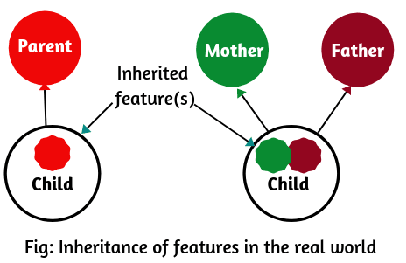
INHERITANCE
Inheritance: Family Recipes Passed Down Through Inheritance enables objects to inherit properties and behavior from other objects, just like family recipes passed down through generations. It promotes code reuse, extensibility, and promotes a hierarchical relationship between classes.

Slide 15
INHERITANCE
Inheritance is a mechanism in which a new class (subclass or derived class) can inherit attributes and methods from an existing class (superclass or base class). It promotes code reusability and establishes a relationship between classes.

Slide 16
INHERITANCE
// Subclass inheriting from //Animal
class Dog extends Animal {
void bark() {
System.out.println("Dog is barking");
}
}
// Superclass
class Animal {
void eat() {
System.out.println("Animal is eating");
}
}

